Slide 1
Data Grand Prix: Building and Visualizing Formula 1 Stats with REST API

Slide 2
Objective
Explore and visualize Formula 1 statistics using data sourced from a REST API.
Tools & Technologies:
Postman for API calls
AWS S3 for data storage
Spark for data processing
AWS Glue & Athena for data cataloging and querying
AWS RDS & MySQL Workbench for database management

Slide 3
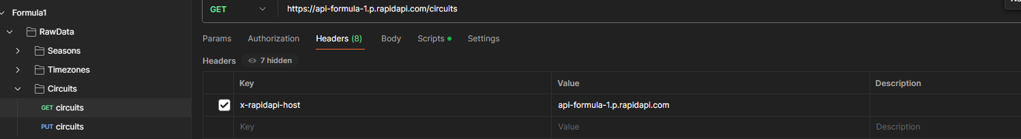
Data Collection and Initial Storage
Phase 1: Extracting Nested JSON Files from API
Platform: Rapid API for accessing Formula 1 data.
Tools:
Postman for managing API calls.
AWS S3 Bucket for storing retrieved data.
Process:
Create GET and PUT requests in Postman.
Use pre signed URLs to upload data to S3.

Slide 4
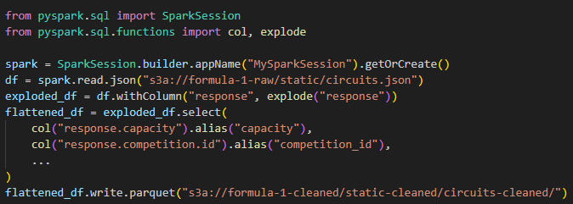
Data Transformation
Phase 2: Transforming Nested JSON files to Parquet Format
Tools: Apache Spark for data transformation.
Process:
Use Spark to flatten nested JSON files.
Convert and save data in Parquet format.

Slide 5
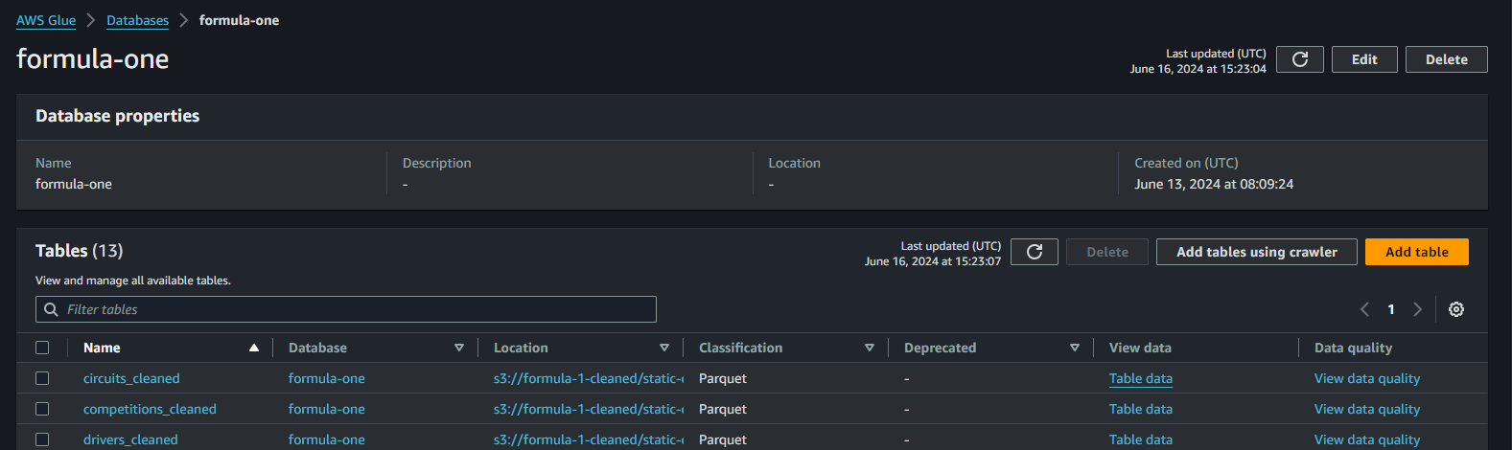
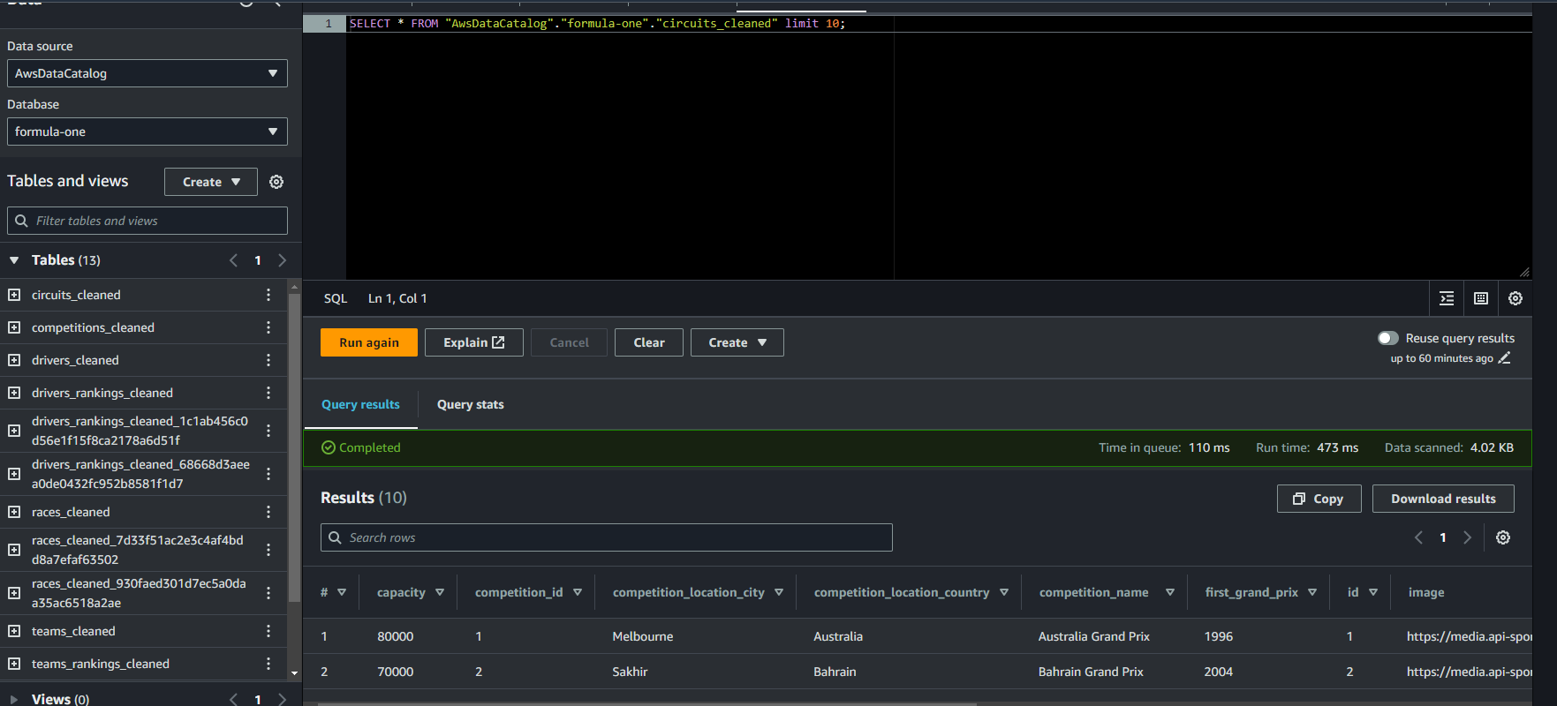
Data Cataloging
Phase 3: Creating Tables from Parquet Files
Tools: AWS Glue for data cataloging.
Process:
Create a Crawler to process Parquet files and create schemas.
Use AWS Athena to query and verify tables.

Slide 6
Database Integration
Phase 4: Creating an RDS Instance and MySQL Connector
Tools:
AWS RDS for database hosting
MySQL Workbench for database management.
Process:
Set up RDS instance.
Connect RDS to MySQL Workbench using a connector.
Create tables in MySQL Workbench to mirror AWS Glue tables.

Slide 7
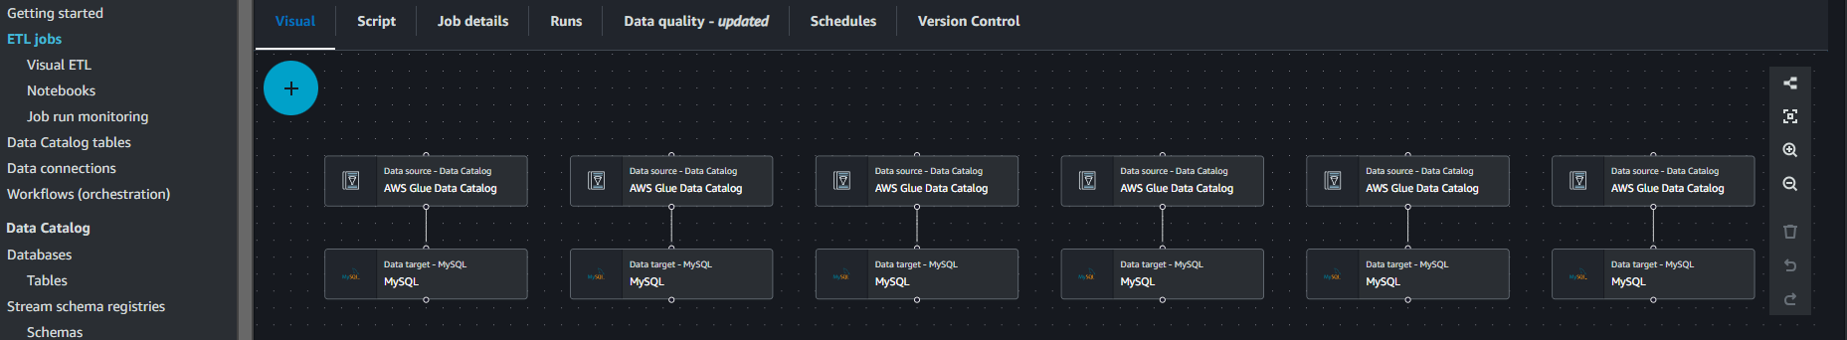
ETL Process
Phase 4 (continued): Data Migration
Tools:
AWS Glue Studio for ETL jobs.
Process:
Create and run ETL jobs to migrate data from AWS Glue tables to RDS tables.

Slide 8
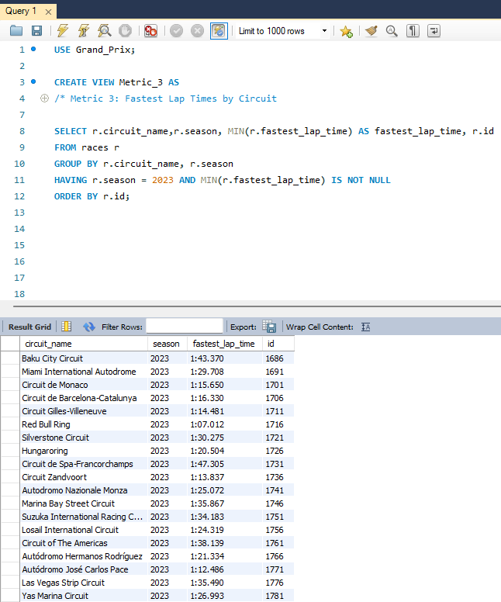
Data Analysis
Phase 5: Getting Data from Database for Analysis
Process:
Use MySQL Workbench to query the data.
Optionally connect to other visualization tools (e.g., Tableau, Power BI) for advanced analytics.

Slide 9
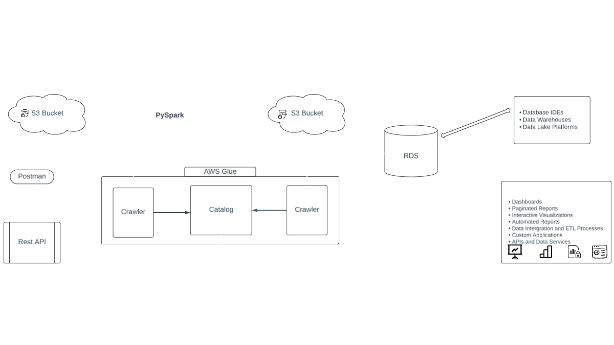
Project Architecture
Final Architecture Overview

Slide 10
Skills and Insights
Key Skills Demonstrated
API Management: Using Postman and REST APIs.
Cloud Services: AWS S3, AWS Glue, AWS RDS, AWS Athena.
Data Processing: Apache Spark for transforming and cleaning data.
Database Management: MySQL Workbench and ETL processes.
Data Visualization: Potential integration with tools like Tableau or Power BI.

Slide 11
Conclusion
Takeaways and Future Directions
Learnings:
Hands-on experience with data extraction, transformation, loading, and analysis.
Future Work:
Expand data sources.
Enhance data visualization.
Implement real-time data processing and analytics.

Slide 12
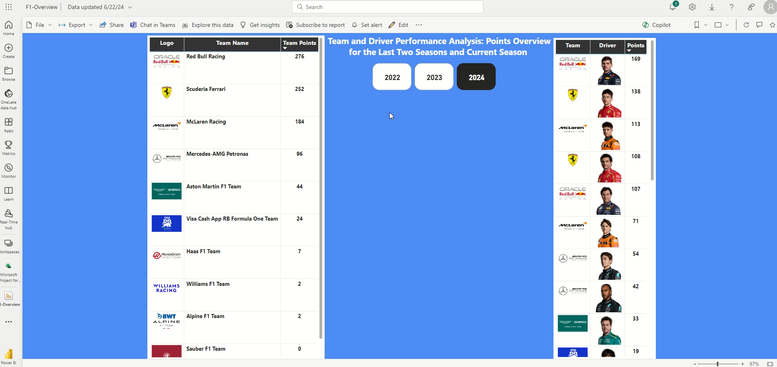
Bonus

